Slide 1

Viewing
Part I (History and Overview of Projections)

Slide 2
Announcement
Geometry Caching and Pixar’s Pipeline
Michael Frederickson '08 and Maxwell Planck
Date: Tuesday, October 9th, 4pm
Location: CIT 368

Slide 3
Lecture Topics
History of Projection in Art
Geometrical Constructions
Types of Projection (Parallel and Perspective)

Slide 4
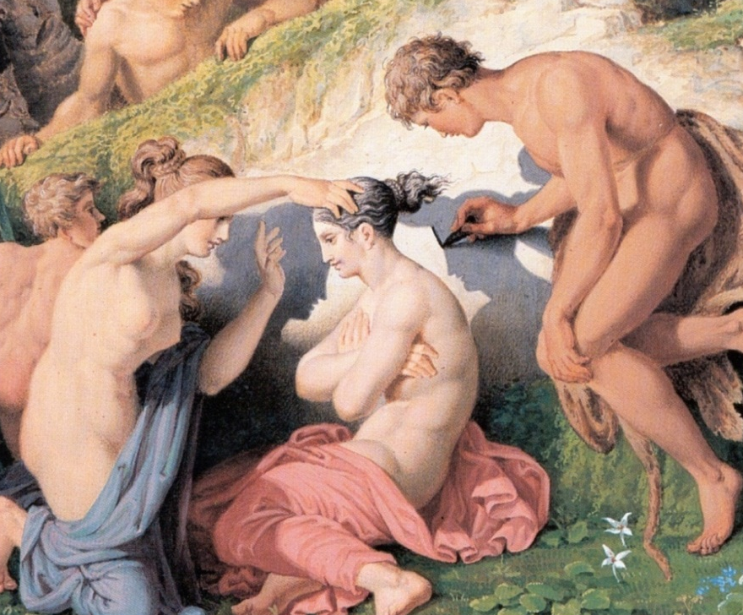
Drawing as Projection (Turning 3D to 2D)
Painting based on mythical tale as told by Pliny the Elder: Corinthian man traces shadow of departing lover.
Projection through use of shadows
Detail from: The Invention of Drawing (1830) – Karl Friedrich Schinkle (Mitchel p.1)

Slide 5
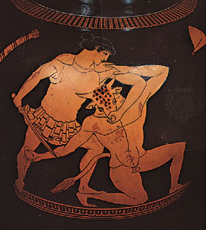
Early Forms of Projection (1/2)
Plan view (parallel, specifically orthographic, projection) from Mesopotamia (2150 BC): Earliest known technical drawing in existence
Greek vase from the late 6th century BC: Shows signs of attempts at perspective!
Note relative sizes of thighs and lower legs of minotaur
Carlbom Fig. 1-1
Theseus Killing the Minotaur by the Kleophrades Painter

Slide 6
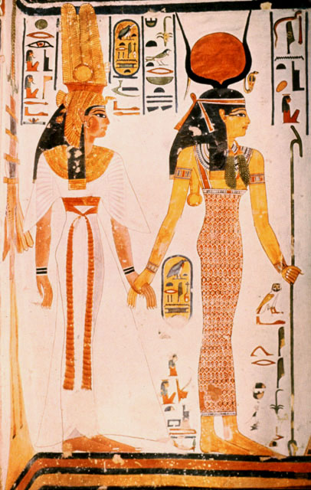
Early Forms of Projection (2/2)
Ancient Egyptian Art:
Multiple Viewpoints
Parallel Projection
Tomb of Nefertari, Thebes (19th Dyn, ~1270 BC), Queen led by Isis. Mural
Note how the depiction of the body implies a front view but the feet and head imply side view (early cubism)

Slide 7
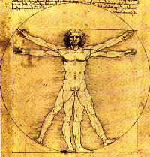
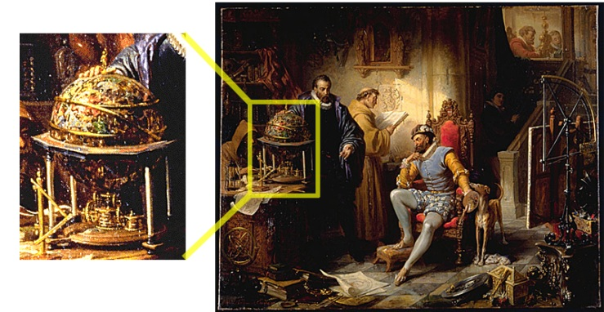
The Renaissance
Starting in the 13th century (AD): New emphasis on importance of individual viewpoint, world interpretation, power of observation (particularly of nature: astronomy, anatomy, etc)
Massaccio, Donatello, Leonardo, Newton
Universe as clockwork: rebuilding the universe more systemically and mechanically
Ender, Tycho Brahe and Rudolph II in Prague (detail of clockwork), c. 1855

Slide 8
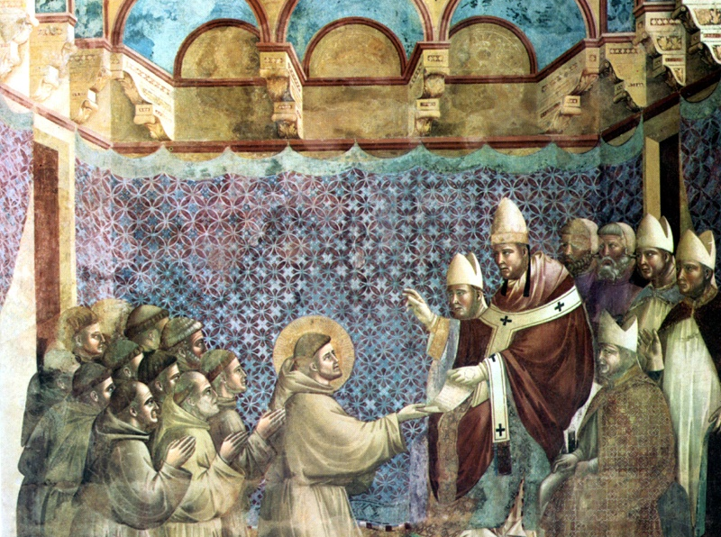
Early Attempts at Perspective
In art, an attempt to represent 3D space more realistically
Earlier works invoke a sense of 3D space but not systematically
Lines converge, but no single vanishing point
Giotto
Franciscan Rule Approved
Assisi, Upper Basilica, c.1295-1300

Slide 9
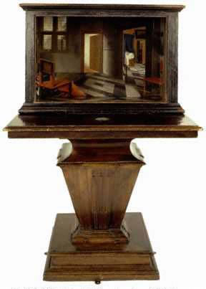
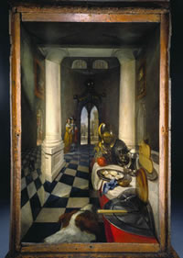
Brunelleschi and Vermeer
Brunelleschi invented systematic method of determining perspective projections (early 1400’s). He created demonstration panels with specific viewing constraints for complete accuracy of reproduction.
The perspective is accurate only from one POV
Vermeer created perspective boxes where picture, when viewed through viewing hole, had correct perspective
Vermeer on the web:
http://www.grand-illusions.com/articles/ mystery_in_the_mirror/
http://essentialvermeer.20m.com/
http://brightbytes.com/cosite/what.html
Perspective Box Samuel van Hoogstraten National Gallery, London
Perspective Box of a Dutch Interior Samuel van Hoogstraten National Gallery, London

Slide 10
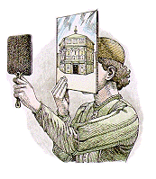
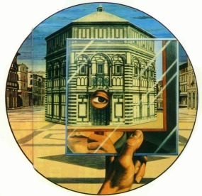
Brunelleschi’s Method
mirror
painting
Brunelleschi was reported to have used this setup to determine the accuracy of his paintings
The realism of his paintings are evidence that Brunelleschi had some systematic method for determining perspective projections, although the procedure he used was never documented
His illusion inspired other artists to explore linear perspective
baptistry
Image credit: COGS011 (Perception, Illusion and Visual Art, William Warren)

Slide 11
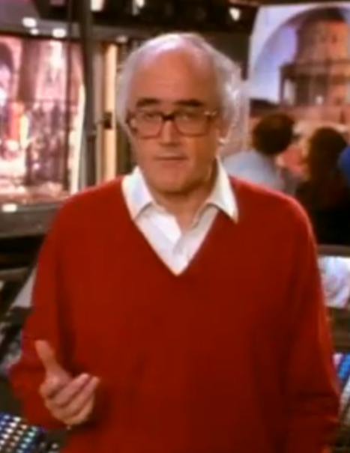
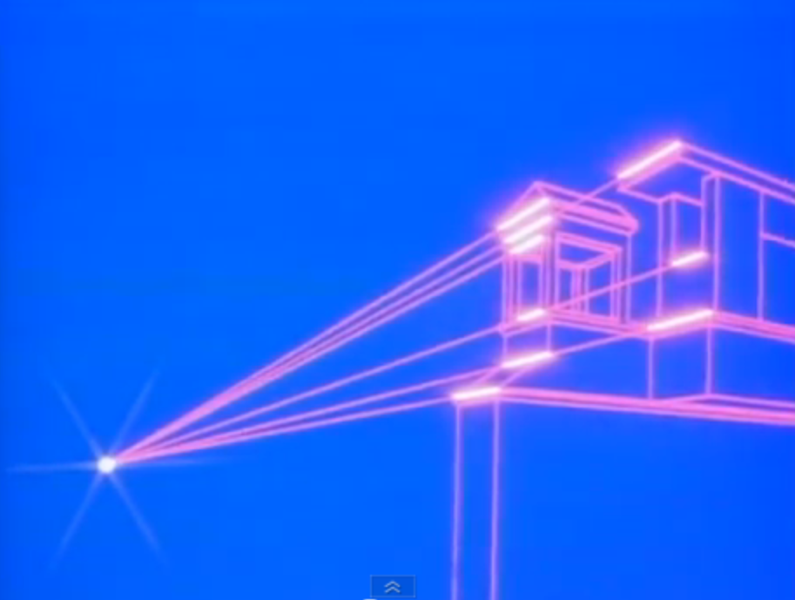
James Burke: “Masters of Illusion”
http://www.youtube.com/watch?v=YU5khzhizNI
http://www.youtube.com/watch?v=0jrqBJPhqq4

Slide 12

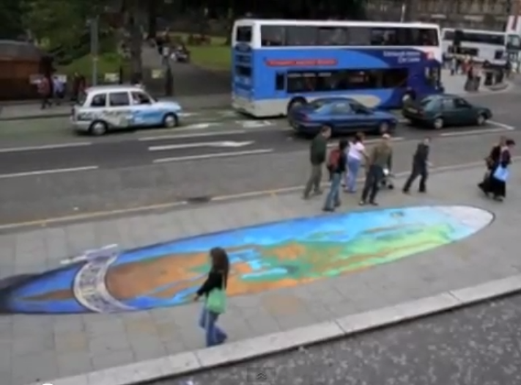
Forced Perspective Art
http://www.youtube.com/watch?v=uzNVo8NbpPI

Slide 13
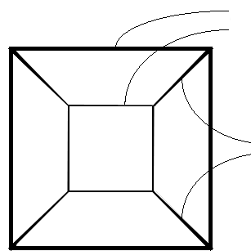
Rules of Linear Perspective
Driving ideas behind Linear Perspective:
Parallel lines converge (in 1, 2, or 3 axes) to vanishing point
Objects farther away are more foreshortened (i.e., smaller) than closer ones
Example: perspective cube
edges same size,
with farther ones smaller
parallel edges converging

Slide 14
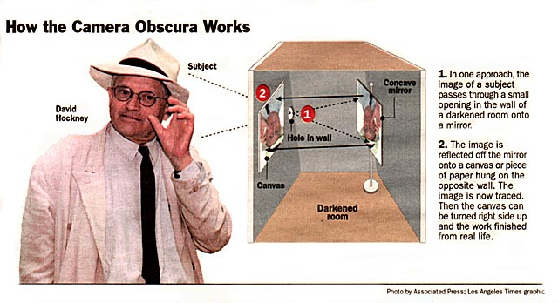
A Similar Idea: Camera Obscura
An artist named David Hockney proposed that many Renaissance artists, including Vermeer, might have been aided by camera obscura while painting their masterpieces, raising a big controversy.
David Stork, a Stanford optics expert, refuted Hockney’s claim in the heated 2001 debate about the subject among artists, museum curators and scientists. He also wrote the article “Optics and Realism in Renaissance Art”, using scientific techniques to disprove Hockney’s theory.
Hockney, D. (2001) Secret
Knowledge: Rediscovering
the Lost Techniques of
the Old Masters.
New York: Viking Studio.
Stork, D. (2004) Optics
and Realism in Renaissance Art.
Scientific American 12, 52-59.

Slide 15
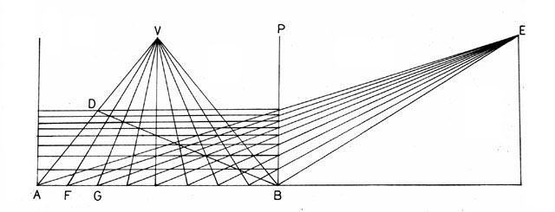
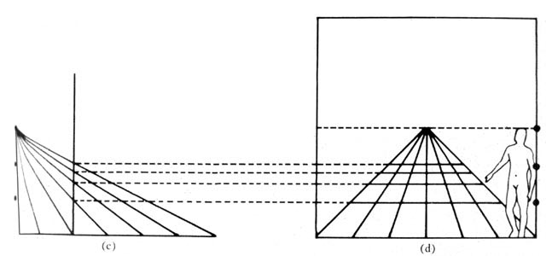
Linear Perspective (Vanishing Points)
Both Da Vinci and Alberti created accurate geometric ways of incorporating linear perspective into a drawing using the concept vanishing points
viewing distance
Distance Point
Da Vinci’s Method
“Little Space”
perpendicular
CP
transversals
diagonals
Alberti’s Method
baseline
Image credit: COGS011 (Perception, Illusion and Visual Art, William Warren)

Slide 16
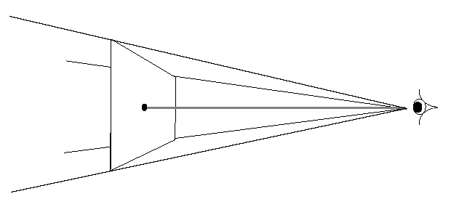
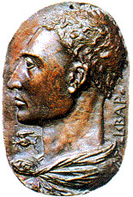
Alberti on Linear Perspective (View Points)
Published first treatise on perspective, Della Pittura, in 1435
“A painting [the projection plane] is the intersection of a visual pyramid [view volume] at a given distance, with a fixed center [center of projection] and a defined position of light, represented by art with lines and colors on a given surface [the rendering].” (Leono Battista Alberti (1404-1472), On Painting, pp. 32-33)
A different way of thinking about perspective from the vanishing point

Slide 17
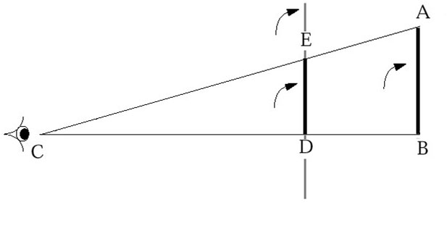
Triangles and Geometry (1/2)
Idea of “visual pyramid” implies use of triangular geometry
Easy to project object on to an image plane based on
height of object (AB)
distance from eye to object (CB)
distance from eye to picture (projection) plane (CD)
and using relationship CB: CD as AB: ED
picture plane
object
projected object
CB : CD as AB : ED

Slide 18
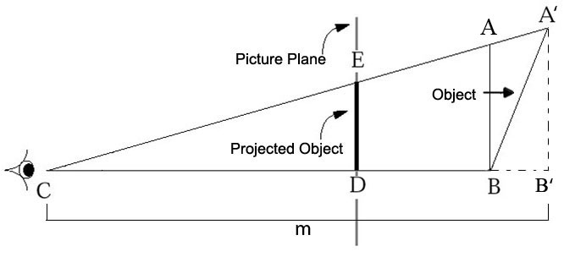
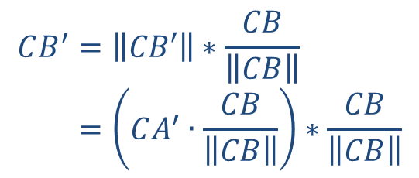
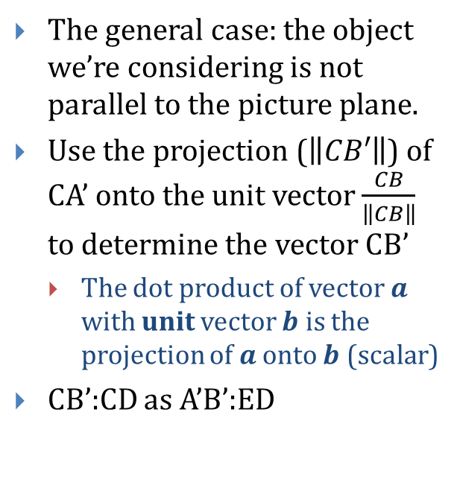
Triangles and Geometry (2/2)
The general case: the object we’re considering is not parallel to the picture plane.
Use the projection ($\left\|CB′\right\|$) of CA’ onto the unit vector $\frac{CB}{\left\|CB\right\|}$ to determine the vector CB’
The dot product of vector $a$ with unit vector $b$ is the projection of $a$ onto $b$ (scalar)
CB’:CD as A’B’:ED
Projection (scalar/magnitude)
Direction (vector)
$$CB^{′}=\left\|CB′\right\|∗\frac{CB}{\left\|CB\right\|} \\ =\left(CA^{′}∙\frac{CB}{\left\|CB\right\|}\right)∗\frac{CB}{\left\|CB\right\|}$$

Slide 19
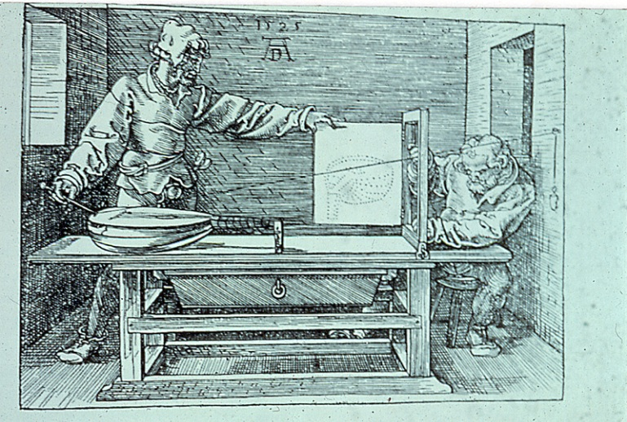
Dürer Woodcut
Concept of similar triangles described both geometrically and mechanically in widely read treatise by Albrecht Dürer (1471-1528).
Refer to chapter 3 of the book for more details.
Albrecht Dürer
Artist Drawing a Lute
Woodcut from Dürer’s work about the Art of Measurement. ‘Underweysung der messung’, Nurenberg, 1525

Slide 20
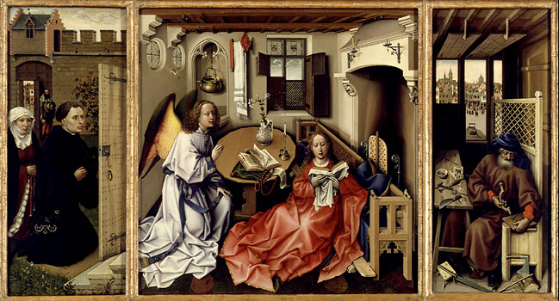
Art of Perspective (1/5)
Robert Campin - The Annunciation Triptych (ca. 1425)

Slide 21
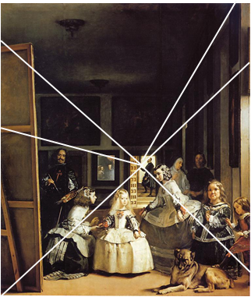
Art of Perspective (2/5)
Point of view influences content and meaning of what is seen
Are royal couple in mirror about to enter room? Or is their image a reflection of painting on far left?
Analysis through computer reconstruction of the painted space: royal couple in mirror is reflection from canvas in foreground, not reflection of actual people (Kemp pp. 105-108)

Slide 22
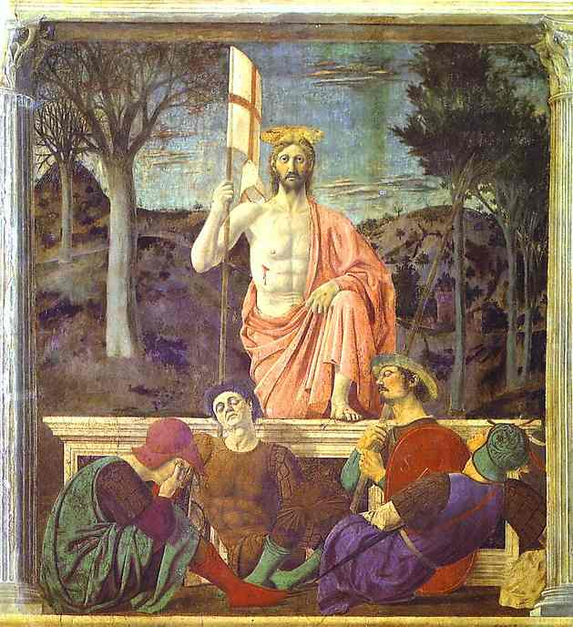
Art of Perspective (3/5)
Perspective can be used in unnatural ways to control perception
Use of two viewpoints concentrates viewer’s attention alternately on Christ and sarcophagus
Piero della Francesca, The Resurrection (1460)

Slide 23
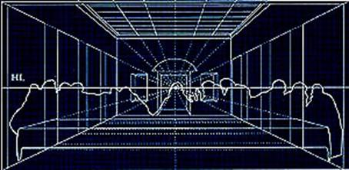
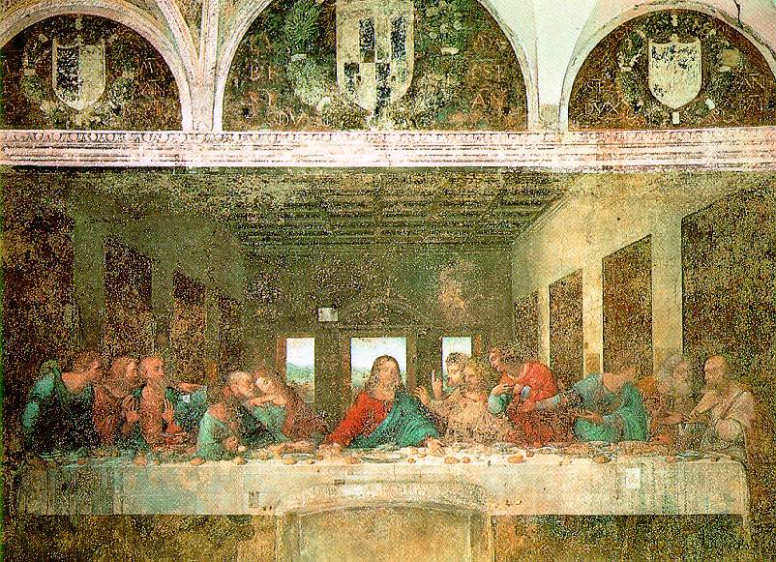
Art of Perspective (4/5)
“Mr. King provides a lively account of Leonardo’s continual hunt for faces he might sketch, and speculates about the identity of the models (including himself) that he might have used to create the faces of Jesus and the apostles. He also writes about how Leonardo presumably started the painting by hammering a nail into the plaster to mark “the very center of the mural, the point on which all lines and all attention would converge: the face of Christ,” and how he used perspective and his knowledge of geometry and architecture to map out the rest of the painting.”
Leonardo da Vinci, The Last Supper (1495)
Ross King, ‘Leonardo and “The Last Supper” ’

Slide 24
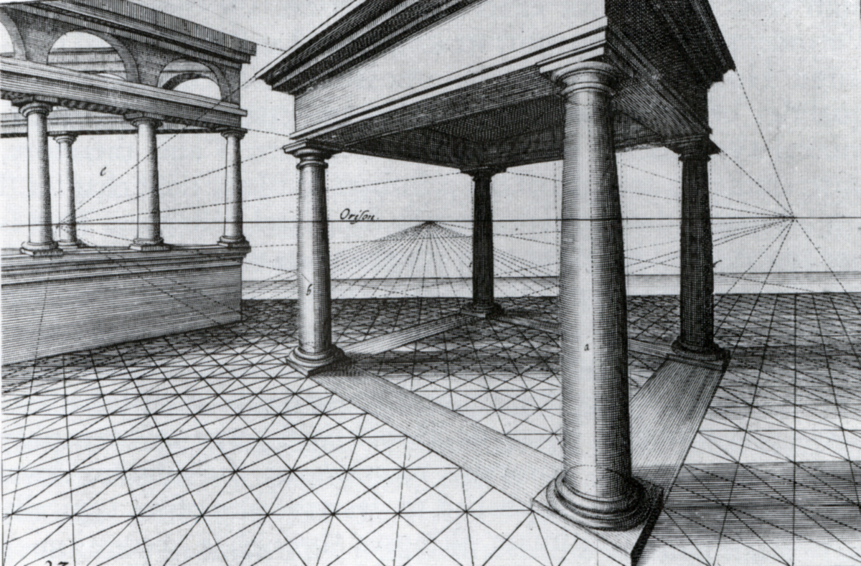
Art of Perspective (5/5)
Perspective
Vredeman de Vries
Kemp p.117
Two Vanishing Points, Two point perspective

Slide 25
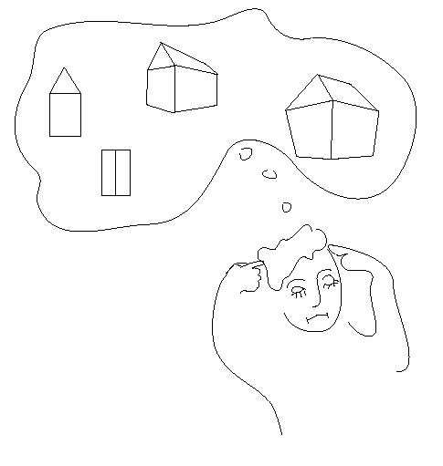
Types of Projection

Slide 26
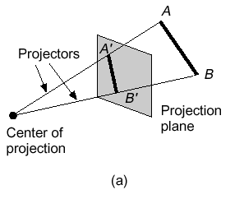
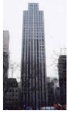
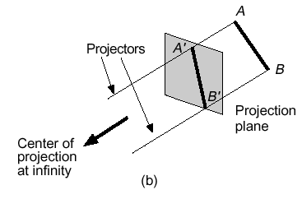
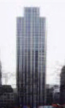
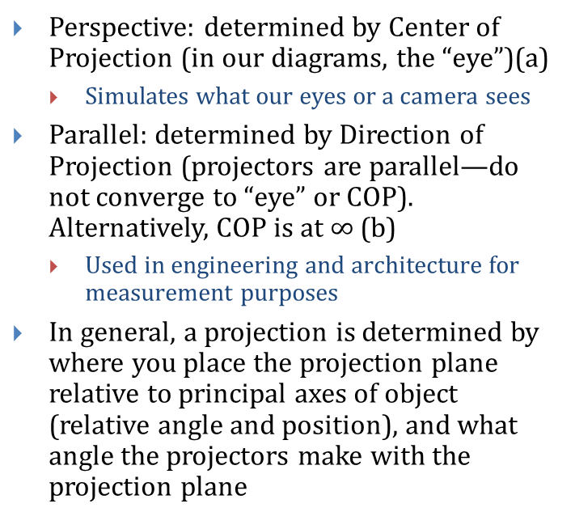
Main Classes of Planar Geometrical Projections
Perspective: determined by Center of Projection (in our diagrams, the “eye”)(a)
Simulates what our eyes or a camera sees
Parallel: determined by Direction of Projection (projectors are parallel—do not converge to “eye” or COP). Alternatively, COP is at $∞$ (b)
Used in engineering and architecture for measurement purposes
In general, a projection is determined by where you place the projection plane relative to principal axes of object (relative angle and position), and what angle the projectors make with the projection plane

Slide 27
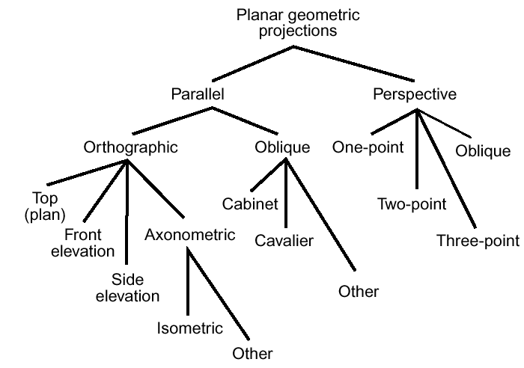
Logical Relationship Between Types of Projections

Slide 28
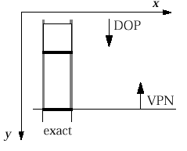
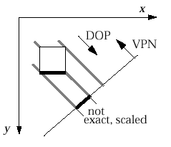
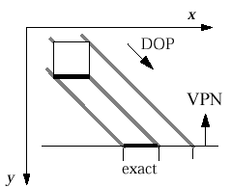
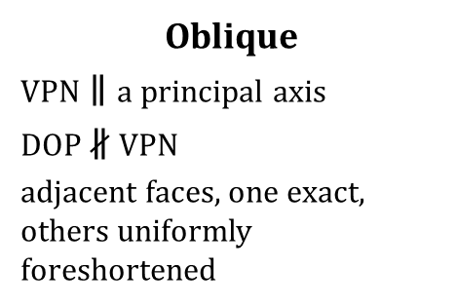
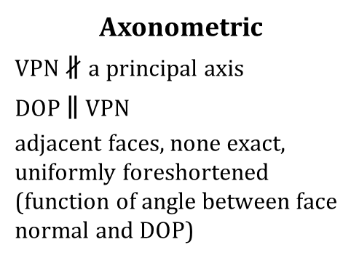
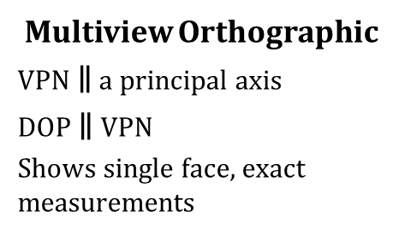
Overview of Parallel Projections
Multiview Orthographic
VPN $∥$ a principal axis
DOP $∥$ VPN
Shows single face, exact measurements
Axonometric
VPN $∦$a principal axis
DOP $∥$ VPN
adjacent faces, none exact, uniformly foreshortened (function of angle between face normal and DOP)
Oblique
VPN$∥$a principal axis
DOP $∦$ VPN
adjacent faces, one exact, others uniformly foreshortened

Slide 29
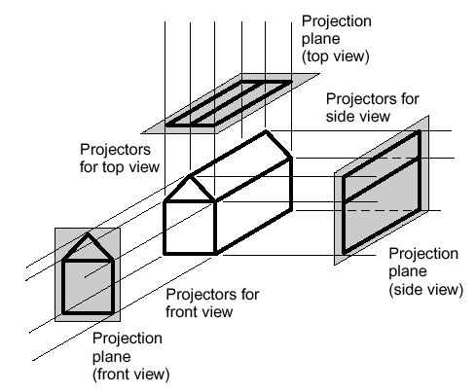
Multiview Orthographic (Parallel)
Used for:
engineering drawings of machines, machine parts
working architectural drawings
Pros:
accurate measurement possible
all views are at same scale
Cons:
does not provide “realistic” view or sense of 3D form
Usually need multiple views to get a three-dimensional feeling for object

Slide 30
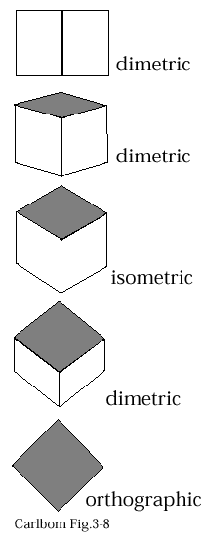
Axonometric (Parallel)
Same method as multiview orthographic projections, except projection plane not parallel to any of coordinate planes; parallel lines equally foreshortened
Isometric: Angles between all three principal axes equal (120º). Same scale ratio applies along each axis
Dimetric: Angles between two of the principal axes equal; need two scale ratios
Trimetric: Angles different between three principal axes; need three scale ratios

Slide 31
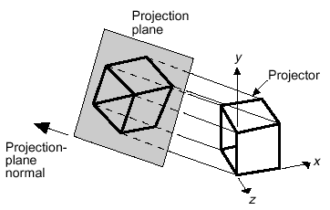
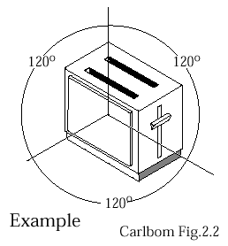
Isometric Projection
Used for:
catalogue illustrations
patent office records
furniture design
structural design
3d Modeling in real time (Maya, AutoCad, etc.)
Pros:
don’t need multiple views
illustrates 3D nature of object
measurements can be made to scale along principal axes
Cons:
lack of foreshortening creates distorted appearance
more useful for rectangular than curved shapes
Construction of an isometric projection:
projection plane cuts each principal axis by 45°

Slide 32

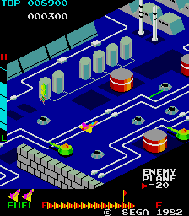
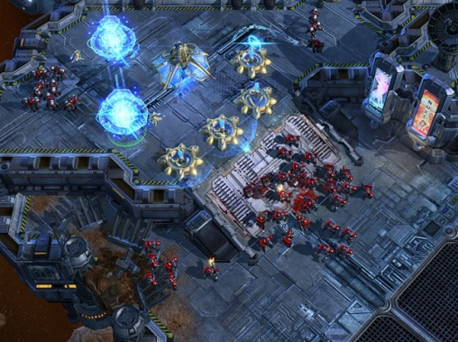
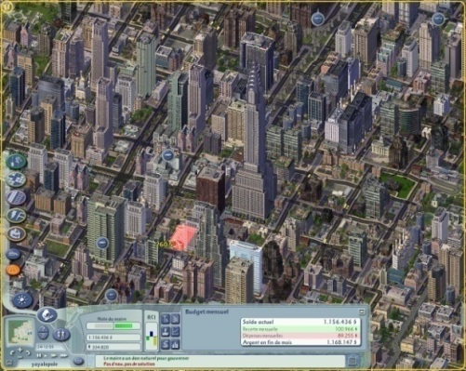
Axonometric Projection in Games
Video games have been using isometric projection for ages.
It all started in 1982 with Q*Bert and Zaxxon which were made possible by advances in raster graphics hardware.
Still in use today when you want to see things in distance as well as things close up (e.g. strategy, simulation games).
SimCity IV, StarCraft II
While many games technically use axonometric views, the general style is still referred to isometric or inappropriately, “2.5D”/ “three quarter”.

Slide 33

Oblique Projection (Parallel)
Projectors at oblique angle to projection plane; view cameras have accordion housing, can adjust the projection plane
Pros:
can present exact shape of one face of an object (can take accurate measurements): better for elliptical shapes than axonometric projections, better for “mechanical” viewing
lack of perspective foreshortening makes comparison of sizes easier
displays some of object’s 3D appearance
Cons:
objects can look distorted if careful choice not made about position of projection plane (e.g., circles become ellipses)
lack of foreshortening (not realistic looking)

Slide 34



Examples of Oblique Projections
Plan oblique projection of city
Construction of
oblique parallel projection
Front oblique projection of radio
(Carlbom Fig. 2-4)

Slide 35




Rules for Constructing Oblique Views
Rules for placing projection plane for oblique views: projection plane should be chosen according to one or several of following:
parallel to most irregular of principal faces, or to one which contains circular or curved surfaces
parallel to longest principal face of object
parallel to face of interest
Projection plane parallel to circular face
Projection plane not parallel to circular face

Slide 36





Main Types of Oblique Projections
$$x$$
Cavalier: Angle between projectors and projection plane is 45$°$. Perpendicular faces projected at full scale.
Cabinet: Angle between projectors and projection plane: $\tan^{−1}\left(2\right)=63.4°$. Perpendicular faces projected at 50% scale
DOP
VPN
$$y$$
$$x$$
DOP
VPN
$$y$$

Slide 37

A Desk in Parallel
Cavalier
Cabinet
Multiview Orthographic

Slide 38

Perspective Projections
Used for:
Fine Art
Human visual system…
Pros:
Gives a realistic view and feeling for 3D form of object
Cons:
Does not preserve shape of object or scale (except where object intersects projection plane)
Different from a parallel projection because
Parallel lines not parallel to the projection plane converge
Size of object is diminished with distance
Foreshortening is not uniform
Two understandings: Vanishing Point and View Point
There are also oblique perspective projections (same idea as parallel oblique), we’ll see an example next lecture
If we were viewing this scene using parallel projection, the tracks would not converge

Slide 39


Vanishing Points (1/2)
Lines extending from edges converge to common vanishing point(s)
For right-angled forms whose face normals are perpendicular to the x, y, z coordinate axes, number of vanishing points = number of principal coordinate axes intersected by projection plane
z
Three Point
Perspective
One Point Perspective
(z-axis vanishing point)
Two Point Perspective
(z and x-axis vanishing points)
(z, x, and y-axis vanishing points)

Slide 40


Vanishing Points (2/2)
What happens if same form is turned so its face normals are not perpendicular to x, y, z coordinate axes?
New viewing situation: cube is rotated, face normals no longer perpendicular to any principal axes.
Although projection plane only intersects one axis (z), three vanishing points created.
Can still achieve final results identical to previous situation in which projection plane intersected all three axes.
Unprojected cube depicted here with parallel projection
Perspective drawing
of the rotated cube

Slide 41


The Single Viewpoint
Art employs the vanishing point idea while computer graphics uses the view point concept, where your view point is the location of the virtual camera
Rays of light reflecting off of an object converge to the point of the viewer’s eye
Lines representing light intersect the picture plane thus allowing points in a scene to be projected along the path of light to the picture plane (Basis for Ray Tracing)
Concept of similar triangles described earlier applies here

Slide 42


Vanishing Points and the View Point (1/4)
We’ve seen two pyramid geometries for understanding perspective projection:
Perspective image is intersection of a plane with light rays from object to eye (COP).
Perspective image is result of foreshortening due to convergence of some parallel lines toward vanishing points.

Slide 43

Vanishing Points and the View Point (2/4)
We can combine the two:

Slide 44


Vanishing Points and the View Point (3/4)
Project parallel lines AB, CD on xy plane
Projectors from eye to AB and CD define two planes, which meet in a line which contains the view point, or eye
This line does not intersect projection plane (XY) because it’s parallel to it. Therefore, there is no vanishing point

Slide 45


Vanishing Points and the View Point (4/4)
Lines AB and CD (this time with A and C behind the projection plane) projected on xy plane: A’B and C’D
Note: A’B not parallel to C’D
Projectors from eye to A’B and C’D define two planes which meet in a line which contains the view point
This line does intersect projection plane
Point of intersection is vanishing point

Slide 46

Next Time: Projection in Computer Graphics

